Slide 1
Robust Geographical Incrementality Testing: An Ensemble Approach Integrating Google TBR, Google BSTS, and Structural Equation Modeling
June 28, 2026

Slide 2
Introduction
This study proposes a multi‑stage causal framework that integrates observational causal discovery with density‑based stratification and triangulated causal estimation. Rather than matching blindly on pre‑period trends, the framework constrains the matching process using empirically derived causal priors to prevent structurally dissimilar markets from being paired. Standard geo-experiments rely on 'Greedy' algorithms to match test and control markets. But here is the problem: these algorithms assume all markets are fundamentally exchangeable—treating New York City and rural Montana as if they behave the same just because their revenue trends look similar for a few weeks. This assumption fails in the real world, introducing massive treatment effect heterogeneity bias that inflates variance, hides true ROI, and leads to wrong decisions and experiments.
The study introduces a four‑phase integrated pipeline: Stage 1: Discovery (Causal Priors): First, we use a panel Structural Equation Model (SEM) to uncover which media channels actually drive revenue. This gives us a Responsiveness Score per market—telling us exactly how sensitive New York is to Brand spend compared to Montana. Stage 2: Design (Stratified Matching): We use Weighted DBSCAN approach—a density-based clustering algorithm—to let the data naturally group markets into genuine cohorts. Crucially, we incorporate the SEM-derived Responsiveness Score as a weighted feature. We then run the standard Greedy matching algorithm, but we constrain it to operate strictly within each cohort. This prevents the algorithm from matching a large DMA with a small one—effectively 'de-biasing' the greedy approach at its core.
Stage 3: Validation (Safety Gates): Before spending a dollar on a live test, we simulate a synthetic intervention. This allows us to calculate the Minimum Detectable Effect (MDE) and run rigorous safety gates—AA tests, drift checks, and correlation thresholds—to guarantee the design is structurally sound. Stage 4: Analysis (Triangulated Estimation): To prevent algorithmic bias, we don't rely on just one model. We triangulate the incremental lift using three independent frameworks: Time Based Regression, Quantile Random Forest, and Bayesian Structural Time-Series. This ensemble gives us robust, decision-ready confidence intervals.

Slide 3
Introduction Key Take Aways
Phase | Action | Key Metric
1. Discovery | SEM -> Responsiveness Score (Causal Priors) | Identifies drivers without external instruments
2. Design | Weighted DBSCAN + Cluster-Constrained Greedy | Prevents cross-type matches
3. Validation | Simulate Test -> MDE & Safety Gates | Guarantees structural integrity
4. Analysis | Triangulated Ensemble (DiD + QRF + Bayesian) | 2-out-of-3 consensus for significance

Slide 4
Problem Statements Pt. 1
The Measurement Challenge in a Multi‑Channel Ecosystem:
The digital advertising ecosystem has evolved into a complex, multi‑channel environment where brands allocate significant budgets across search, social, and programmatic platforms. Measuring the true incremental return on ad spend (iROAS) has become the central challenge for modern marketing analytics. Traditional methods for measuring marketing success are flawed. They often ignore outside factors, struggle to track the complicated steps customers take before buying, and get confused by coincidences. Because of this, it's hard to tell if an ad actually caused a sale, or if the person was going to buy anyway.
The Shift to Randomized Geo‑Experiments: To overcome these observational limitations, the industry has increasingly turned to randomized geo‑based experiments. As Shaw (2025) articulates, geographic experiments—where the units of randomization are entire regions such as cities or Designated Market Areas—have emerged as a gold standard methodology. Such experiments are often preferred over individual‑level randomization because they are robust to network spillover effects and can be implemented without relying on sensitive user‑level data, which is increasingly restricted by privacy regulations.
The Vulnerability of "Greedy" Matching Designs: A critical bottleneck remains in the design phase of these experiments. Standard practice relies on "greedy" matching algorithms that pair test and control geos primarily based on pre‑period outcome similarity. However, as highlighted in recent methodological critiques, matching solely on historical revenue risks pairing fundamentally incompatible markets. Two geographic markets may exhibit coincidentally similar short‑term revenue trajectories while possessing vastly different underlying structural dynamics, such as population density, baseline ad‑sensitivity, or brand penetration.
In addition, the greedy algorithm is "myopic"—it iteratively selects the best control for the first treated geo and then discards the remaining controls from consideration. This means that a control geo that would have been an excellent match for a later treated geo is permanently excluded, unnecessarily reducing the donor pool and inflating variance.
The Impact of Treatment Effect Heterogeneity: This greedy matching approach implicitly assumes that treatment effects are homogeneous across all regions. In reality, according to Chen et al. (2021), response metrics across geographic regions are often "very heavy‑tailed due to geo heterogeneity." When algorithms inadvertently match these highly heterogeneous units, reliable estimation becomes difficult, severely inflating variance and undermining the experiment's statistical power.
Furthermore, applying traditional regression models to staggered rollouts under these heterogeneous conditions mathematically distorts results; as Callaway and Sant'Anna (2021) proved, it can mathematically subtract newly treated geos from already‑treated geos, creating "negative weights" that produce biased estimates.
Notes:
The Measurement Challenge in a Multi-Channel Ecosystem
Brands struggle to measure true incremental return on ad spend (iROAS) due to complex, multi-channel paths and external noise, making it difficult to distinguish ad-driven conversions from organic growth.
The Shift to Randomized Geo-Experiments
To mitigate privacy concerns and spillover effects, the industry increasingly uses geo-based experiments, treating entire regions as randomized units. This approach is widely considered the gold standard for robust measurement.
The Vulnerability of "Greedy" Matching Designs
Standard "greedy" matching algorithms often fail by prioritizing short-term revenue similarity over structural compatibility (e.g., demographics, ad-sensitivity). Furthermore, their "myopic" nature—sequentially locking in matches—discards viable donor units, unnecessarily inflating variance.
The Impact of Treatment Effect Heterogeneity
Greedy matching assumes homogeneous treatment effects, ignoring the reality that regional responses are often "heavy-tailed." When algorithms pair incompatible units, estimation variance increases, undermining statistical power. Moreover, applying traditional regression to staggered rollouts in these conditions creates "negative weights," leading to biased results as documented by Callaway and Sant'Anna (2021).
The Verifiability Deficit (Addressing Transparency): Stakeholders distrust unverified results. Current bias correction methods use hidden "intent proxies." When a model attributes sales to an unobservable channel (e.g., Paid Social Meta Ads), users perceive "Allocative Harm" (inflated attribution). Lacking a verifiable ground truth, users remain skeptical.
Incongruence with Expert Mental Models (Addressing Interference): "Black Box" models frequently contradict expert domain knowledge, resulting in inconsistencies. For example, experts know pausing spend in one region causes budget interference (spillover) elsewhere—a physical constraint standard observational models miss. When a model output defies known market physics, the cognitive dissonance erodes expert confidence, causing rejection of even valid insights.
The Strategic-Tactical Disconnect (Addressing Actionability): MMM provides strategic insights but fail to translate high-level strategy into granular campaign execution, leading users to abandon the model's guidance during implementation. This renders the expensive AI system operationally useless for tactical decision-making.
Perceived Instability via Mathematical Uncertainty: Model instability, stemming from mathematical issues that results in erratic budget recommendations to non-technical stakeholders. This perceived volatility triggers “Algorithm Aversion”, leading decision-makers to revert to less accurate but reliable human heuristics.
Callaway, B., & Sant'Anna, P. H. C. (2021). Difference-in-differences with multiple time periods. Journal of Econometrics, 225(2), 200-230.
Chen, A., Longfils, M., & Remy, N. (2021). Trimmed Match Design for Randomized Paired Geo Experiments. Google Research.
Chen, A., & Au, T. C. (2021). Robust Causal Inference for Incremental Return on Ad Spend with Randomized Paired Geo Experiments. Google Research.
Rolnick, D., Aydin, K., Pouget-Abadie, J., Kamali, S., Mirrokni, V., & Najmi, A. (2019). Randomized experimental design via geographic clustering. Proceedings of the 25th ACM SIGKDD International Conference on Knowledge Discovery & Data Mining, 2745-2753.
Zhou, L., Zhang, Q., & Yuan, Y. (2019). Multisource data fusion in internet advertising with machine learning models. IEEE Transactions on Industrial Informatics, 15(12), 6566-6574.

Slide 5
Problem Statements Pt. 2
The Missing Link of Statistical Feasibility: An equally critical problem occurs before the experiment is launched. Marketing teams often set budgets and test durations arbitrarily, without knowing whether their planned spend is even large enough to generate a statistically detectable signal. As emphasized in recent causal machine learning literature, understanding how variables like experiment length and the magnitude of ad spend differentials impact the uncertainty of the measurement is a crucial prerequisite for effective design (Huber, 2024).
Without a rigorous pre‑experiment simulation, teams risk:
Underpowered tests: The budget is too small to overcome natural market noise, resulting in inconclusive p‑values and wasted spend.
Overpowered tests: The budget is unnecessarily large, wasting capital that could have been allocated elsewhere.
Structural failure: The matched markets organically drift apart during the test period due to unobserved, time-varying confounders. This violates the foundational parallel trends assumption required for causal inference, rendering the synthetic counterfactual invalid (Arkhangelsky et al., 2021). Tragically, standard methodologies only uncover this structural divergence post-mortem, after the money has already been spent.
There is no sandbox that simulates the synthetic intervention, calculates the Minimum Detectable Effect (MDE) against pre‑defined statistical thresholds (α, power), and runs safety gates (AA tests, drift checks, correlation diagnostics) before the live test begins. Consequently, teams fly blind into expensive experiments.
The "Which Model is Right?" Dilemma A third problem emerges after the experiment concludes: the choice of estimation framework. Practitioners typically rely on a single model—be it regression, a tree-based model, or a Bayesian structural model. However, each framework has distinct assumptions:
Regression: Parallel trends. It fails when pre‑period trends are noisy or non‑linear.
Tree-Based Model: It requires sufficient historical data. It fails when data is limited or the control pool is small.
Bayesian Structural Model: It requires structural stability. It fails when the pre‑period is too short or the counterfactual is unstable, as it requires good prior knowledge.
If the chosen model happens to fail its underlying assumption for the specific geo‑experiment, the resulting lift estimate is biased—yet the practitioner has no way of knowing this without comparing against alternative models. There is no built‑in mechanism to triangulate estimates and determine whether multiple independent models converge on a consensus. Relying on a single model risks algorithmic bias and undermines confidence in the final budget decision.
Notes:
Arkhangelsky, D., Athey, S., Hirshberg, D. A., Imbens, G. W., & Wager, S. (2021). Synthetic difference-in-differences. The American Economic Review, 111(12), 4088-4118. (Use this to cite the challenges of time-varying confounders and the failure of parallel trends in standard control frameworks).
Huber, M. (2024). Causal Machine Learning and its adoption in marketing. (Use this to cite the importance of rigorous causal ML frameworks and heterogeneity analysis as a prerequisite in modern experimental design).

Slide 6
The Three Core Problems This Study Addresses
Phase | Problem | Consequence
Design | Greedy matching on pre‑period outcomes | Pairs structurally dissimilar markets → Heterogeneity bias
Design | Discarding of controls after matching | Wastes good donors, inflates variance, reduces statistical power
Design | Assumption of homogeneous treatment effects | Fails in real‑world heavy‑tailed distributions (Chen et al., 2021)
Design | Ignoring causal priors in historical data | Missed opportunity to improve stratification with structural knowledge
Validation | No pre‑experiment simulation or safety gates | Underpowered tests, arbitrary budgets, undetected structural drift
Validation | No Minimum Detectable Effect (MDE) calculation | Teams fly blind into expensive live experiments
Analysis | Reliance on a single estimation framework | Algorithmic bias—DiD, QRF, or Bayesian may each fail under different conditions
Analysis | No triangulation or consensus mechanism | Inability to distinguish signal from model‑specific artifacts

Slide 7
Problem Statements: Key Takeaways
Existing methods often disregard rich causal information present in historical data. Modern methodological updates propose grouping regions based on their latent structural identity rather than coincidental revenue trajectories. By matching high‑responsiveness geos with structurally similar peers, they react to external economic shocks in the same way, ensuring the counterfactual holds true throughout the entirety of the treatment period.
This study addresses that missed opportunity. Rather than matching blindly on short‑term trends, we inject empirically derived causal priors—obtained from a Structural Equation Model (SEM)—into the stratification process. By weighting the density‑based clustering with these priors and constraining the greedy matching to operate within each resulting cohort, we prevent cross‑type matches and systematically reduce treatment effect heterogeneity bias. In addition, this study also addresses two additional gaps: the validation gap (no pre‑experiment simulation to confirm statistical feasibility) and the analysis gap (reliance on a single model without triangulation). Overall, this study addresses all three gaps through a unified 4‑stage pipeline:
Gap | Our Solution
Design | Inject empirically derived causal priors (SEM) into DBSCAN stratification; constrain greedy matching to operate within homogeneous cohorts
Validation | Simulate synthetic intervention to calculate MDE against α=0.10, power=0.80; run AA tests, drift checks, and correlation diagnostics before live spend
Analysis | Triangulate lift estimates using Frequentist DiD, Quantile Random Forest (QRF), and Bayesian Structural Time‑Series (CausalImpact); 2‑out‑of‑3 consensus rule determines statistical significance

Slide 8
Objective of the Study
The primary objective of this study is to develop and empirically validate a robust, replicable causal framework for designing, evaluating, and measuring geo‑experiments that reduces matching bias and enhances the precision of incremental lift estimation.
The specific objectives are:
To identify causal media pathways and generate market‑specific responsiveness priors: Estimate a panel SEM with fixed effects to map the causal influence of media channels (e.g., brand, demand generation, PMax) on revenue, and derive a "responsiveness score" for each geo to be used in the design phase.
To stratify geographic markets into internally homogeneous cohorts: Implement a weighted DBSCAN algorithm utilizing correlation distance (metric='correlation', eps=0.10) and SEM‑derived feature weights to objectively cluster DMAs based on revenue, visits, orders, and the responsiveness priors, while isolating volatile outliers (noise).
To develop a cluster‑constrained greedy matching protocol: Integrate Google's Matched Markets algorithm but constrain the search to operate strictly within the DBSCAN‑derived cohorts, preventing cross‑type mismatches and systematically reducing treatment effect heterogeneity bias.
To establish a validation and power analysis protocol: Simulate a synthetic intervention to compute the Minimum Detectable Effect (MDE) against pre‑determined statistical thresholds (α=0.10, power=0.80), utilizing AA tests, drift checks, correlation diagnostics, and pre‑period model fit metrics (RMSE, R²) to certify design integrity before live execution.
To triangulate causal lift estimation: Compare and contrast the incremental revenue estimates generated by three distinct modeling frameworks—Time-Based Regression, Quantile Random Forest (QRF), and Bayesian Structural Time‑Series —using a 2‑out‑of‑3 voting rule to validate results and provide robust, decision‑ready confidence intervals.
To assess the generalizability and limitations: Conduct sensitivity analyses across varying pre‑test and post‑test windows, and characterize the differences between retained dense DMAs and discarded volatile DMAs to define the scope of external validity.

Slide 9
Mapping Objectives to Problem Statements
Problem Statement Gap | Corresponding Objective
Greedy matching ignores causal priors | Objective 1 + 2 + 3
No pre‑experiment simulation or safety gates | Objective 4
Single‑model reliance, no triangulation | Objective 5
Generalizability limitations unknown | Objective 6

Slide 10


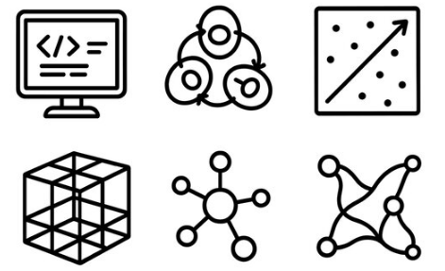


The End-to-End Study Work Flow Ecosystem
A unified, minimal human interference architecture bridging Applied Computing and Strategic Execution.
1. Discovery
SEM dynamically maps cross-channel causal influence.
2. Design
Stratified DBSCAN clustering objectively matches homogenous markets.
3. Simulation
Power Analysis thru synthetic Data Injection
4. Validation
Safety Gates (A/A, Drift) verify structural integrity.
5. Analysis
Triangulated Causal Estimation that calculates exact incremental ROI & exports playbooks.
Notes:
To conclude, this is the complete, end-to-end causal ecosystem. By orchestrating these five distinct computational steps into a single, zero-touch dashboard, we have effectively solved the explainability gap. We move from initial discovery with SEM, to objective market matching, through predictive simulation and rigorous safety gates, all the way to final econometric analysis. This architecture ensures that strategic media planners can launch complex, mathematically sound financial experiments without ever touching a line of code or a vulnerable spreadsheet. Thank you.

Slide 11
Study Workflow
The study is operationalized through a linear, five‑stage methodological workflow that transitions from discovery to actionability.
Stage | Title | Methodology | Key Output
1 | Discovery | Panel SEM with Fixed Effects: Maps cross‑channel causal pathways to produce a geo‑level responsiveness prior (total effect coefficient) without relying on external instruments. | Causal priors for media channels; Geo‑level responsiveness scores.
2 | Design | Weighted DBSCAN (Correlation Distance): Applies metric='correlation', eps=0.10 (r > 0.90), and SEM‑derived empirical feature weights to create dense cohorts while isolating noise. Cluster‑Constrained Greedy Matching: Executes Google Matched Markets independently within each cohort to select test/control pairs, preventing cross‑type matches. | Homogeneous geo cohorts (Dense DMAs retained); Matched test/control pairs.
3 | Simulation | Synthetic Data Injection: Imposes a known "true" lift (e.g., ±$45,000) onto the matched design to simulate the test period and calculate the Minimum Detectable Effect (MDE) against α=0.10 and power=0.80. | Power analysis (MDE); Simulated ground truth for validation.
4 | Validation | Safety Gates & Diagnostics: Runs AA tests, drift checks, correlation diagnostics, and pre‑period model fit metrics (RMSE, R²) to ensure structural integrity of the counterfactual before live execution. | Model diagnostics (RMSE, MAPE); Stability Analysis.
5 | Analysis | Triangulated Causal Estimation: Applies Time-Based Regression, Machine Learning (QRF), and Bayesian Structural Time‑Series (CausalImpact) to the post‑period data. Ensemble uses a 2‑out‑of‑3 consensus rule to determine statistical significance. | 90% Confidence Intervals; Statistical significance verdict; Strategic Playbook (Budget & ROI Recommendation).

Slide 12
Significance of the Study
This research makes the distinct contributions to the causal inference and marketing science literature:
Bridging Observational Priors and Experimental Design: It empirically demonstrates that causal information derived from pre‑experiment observational data (SEM) can be systematically transferred to improve the stratification and matching of geo‑experiments, providing a formal bridge between correlational MMM and experimental lift studies.
De‑biasing the Greedy Algorithm: By constraining greedy matching within DBSCAN cohorts, the study formally addresses the "treatment effect heterogeneity" problem that plagues standard synthetic control designs. It provides a replicable algorithm for ensuring that matched markets are not only similar in outcome trends but also in structural responsiveness to media.
Methodological Triangulation: The ensemble approach (DiD, QRF, CausalImpact) offers a novel robustness framework for marketing science, moving away from single‑point estimates and toward "consensus‑based" causal inference.
Budget Optimization: By ensuring a 2.5x iROAS detection capability with high confidence, the framework allows marketers to confidently scale or reduce channel investments. The simulation confirms that the signal (estimated lift) penetrates natural market noise, reducing the risk of misallocating multi‑million dollar budgets.
Credibility in Measurement: The triangulation framework provides leadership with high‑certainty evidence. The Bayesian tail‑area p‑value (p < 0.01) and the narrow 95% confidence intervals offer robust defense against skepticism regarding "ad waste."

Slide 13
Methodology

Slide 14
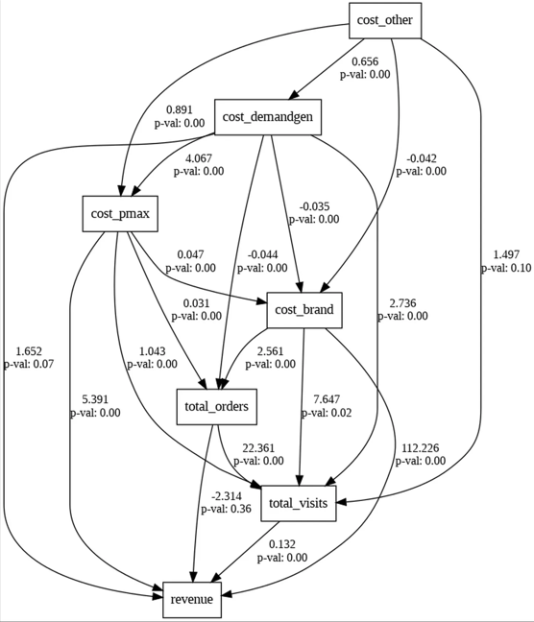
Step 1 – Causal Discovery (SEM)
Structural Equation Modeling (SEM) dynamically maps how different paid media channels influence each other.
This allows us to visually validate causal assumptions before committing budget, guaranteeing we select the channel providing the cleanest incremental signal.
Notes:
Structural Equation Modeling (SEM) dynamically maps how different paid media channels influence each other.
This allows us to visually validate causal assumptions before committing budget, guaranteeing we select the channel providing the cleanest incremental signal.

Slide 15
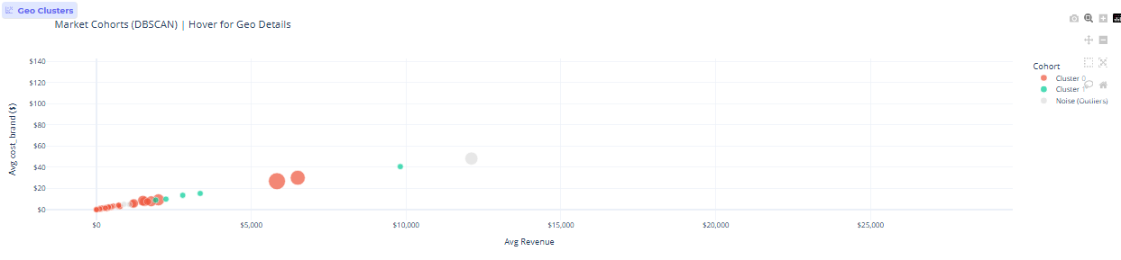
Step 2 – Market Clustering (DBSCAN)
Clustering automates objective market selection, effectively addressing geographic heterogeneity.
The algorithm mathematically groups regions based on historical trajectories, expenditure, and temporal patterns to ensure available control markets are perfectly homogenous twins.
Notes:
K-Means clustering automates objective market selection, effectively addressing geographic heterogeneity.
The algorithm mathematically groups regions based on historical trajectories, expenditure, and temporal patterns to ensure available control markets are perfectly homogenous twins.

Slide 16
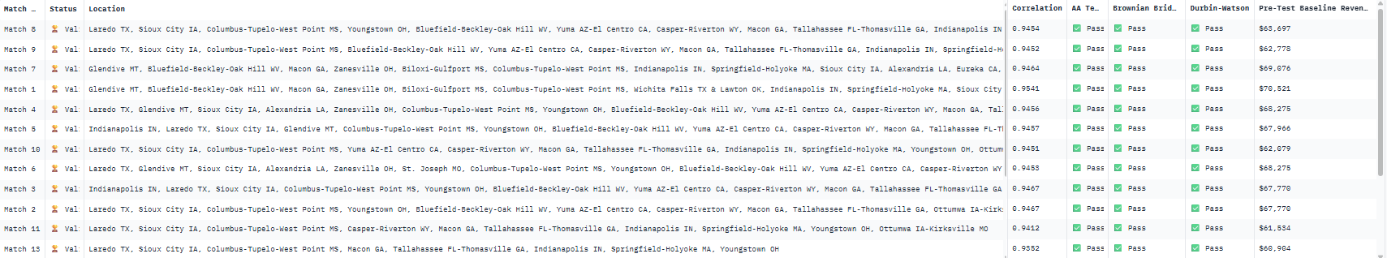
Step 3 – Safety & Execution
Algorithmic gatekeepers force the design through rigorous validation before generating the Execution Playbook.
The system automatically executes A/A Placebo tests, scans for autocorrelation via Durbin-Watson, and monitors model drift using Brownian Bridge diagnostics.
Notes:
The final step acts as a statistical safety net. Before generating the final Execution Playbook, the dashboard forces the design through algorithmic gatekeepers. It automatically runs A/A Placebo tests, scans for autocorrelation via Durbin-Watson, and monitors model drift using Brownian Bridge. The result is a foolproof interface that translates dense econometric theory into a safe, actionable strategy.

Slide 17
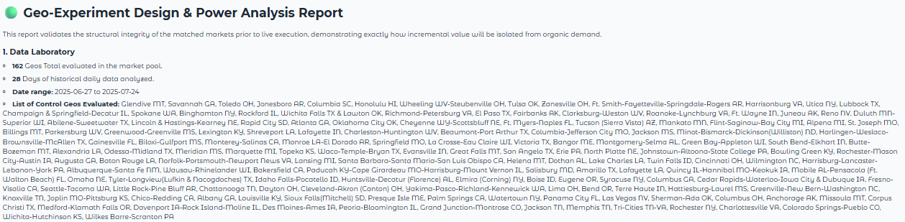
Step 4 – Recommendation Analysis
Notes:
Finally, Step 5 automates the post-test analysis. Once the physical experiment concludes, the system ingests the data and runs a Time-Based Regression (TBR) to calculate the true incremental lift against our modeled counterfactual. Crucially, it translates these complex econometric outputs—including 90% confidence intervals—into executive-ready visual waterfalls and cumulative lift charts. This instantly proves the final ROI, closing the loop from our initial causal hypothesis to a verified, mathematically sound financial return.

Slide 18
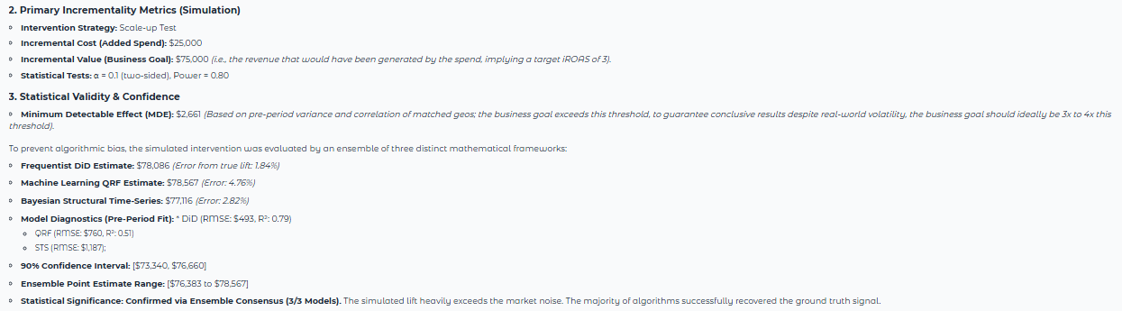
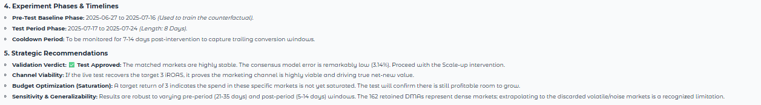
Step 5 – Recommendation Analysis
Notes:
Finally, Step 5 automates the post-test analysis. Once the physical experiment concludes, the system ingests the data and runs a Time-Based Regression (TBR) to calculate the true incremental lift against our modeled counterfactual. Crucially, it translates these complex econometric outputs—including 90% confidence intervals—into executive-ready visual waterfalls and cumulative lift charts. This instantly proves the final ROI, closing the loop from our initial causal hypothesis to a verified, mathematically sound financial return.

Slide 19
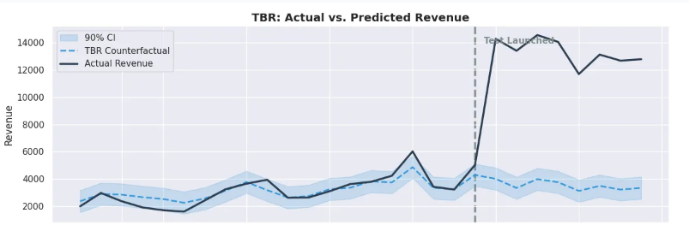
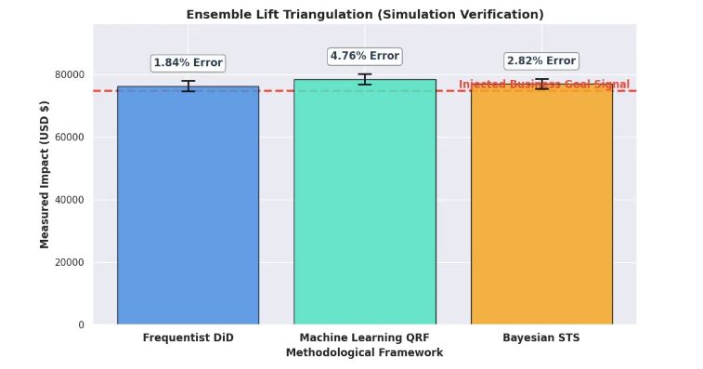
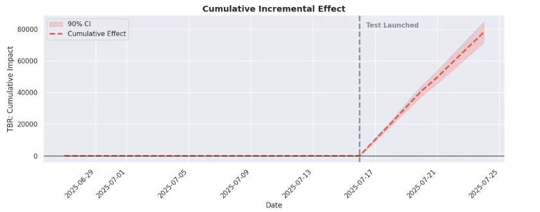
Step 6 – Recommendation Analysis

